Slide 1
Genome Assembly and Annotation
Best Practices, Best Tools
Notes:
Ok. So in this section Im going to talk about Genome Assembly and Annotation and look at some of the tools we have to do that

Slide 2
Structure
AIM:
Help you develop a strategy for performing a genome assembly and assessing its quality
Theory
Sequence Types
Algorithm Basics
Assessing an Assembly
Tools
For Assembly
For Assessment
For Annotation
Notes:
The aim with this section will be to give you a bit of background and help you to come up with a first strategy for doing genome assembly
And to that end we’ll go over a bit of theory on the sequence types and have a look in a general and useful way at the basics of the algorithms – there wont be any hardcore computer science, and how to critically assess an assembly.
Then we’ll look at the tools for actually doing the assembly.

Slide 3
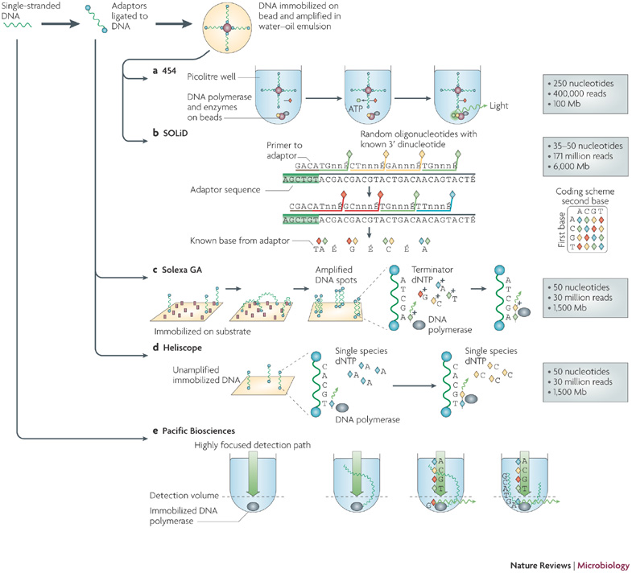
Sequencing
Two major kinds
- Illumina
- Pacific BioSciences
Illumina
Sequence by Synthesis
PacBio
Single Molecule Real Time
Notes:
Ok, so first things first, high throughput sequencing for genome assemlby. At the moment there are two main technologies that that get used. The first is Illumina sequencing by synthesis, this is the older technology and it works basically by using small primers bound to a slide that bind to the ends of DNA fragments that you wash over them. Then these fragments are amplified by PCR to make large clusters of the same sequence. To actually sequence you introduce terminator fluorescent dNTPs in cycles and measure the fluorescence that comes from each spot in each cycle, so you sequence by synthesising a complementary strand.
The other technology is Pacific BioSciences Single molecule system which is based on a slide with tiny zeptoliter holes in it and DNA polymerase tethered to the bottom. When DNA is introduced the polymerase startes to synthesise and incorporates the fluorephores which are recorded as it goes, to get high accuracy each molecule has to be read multiple times

Slide 4
Paired-end and Mate Paired Reads
Paired End
Read both ends of the molecule
Separated by ~ 500 bp
Mate Pair
Circularize long molecules (1-10kbp)
Shear into fragments then sequence
Notes:
The are different ways of preparing the DNA for sequencing that results in some extra information about reads. With Paired end and mate paired strategies then you get info about the distance between the reads. In Paired end you basically read both ends of a molecule that you more or less know the length of, these tend to be separated by about 500 bp in practice.
With Mate Pairs, the fragment is circularized and you cut out and sequence the two end parts, so you end up with a distance of about 10 kbp in practice. If the cutting goes wrong though, then you end up with the middle of the molecule and a shorter distance.
So the take home of this is, different preparations let you know the distance between reads in the original fragment.

Slide 5
Brief sequence comparison
 | Illumina | PacBio
Length | <300bp | <10kb
Reads per run | 25 – 400 million | ~50 thousand
accuracy | >99% | ~86%
Notes:
So there are some more practical differences, Illumina reads are much shorter, though that headline figure from PacBio is more like 5kb in practice. You do get many more reads from Illumina and much higher accuracy, but it isn’t cut and dried as to which you should use for every application, the decision will be very case dependent. These are the basic facts you should know though

Slide 6
The Assembly Problem
Rebuilding a shredded text
Rick Astley accidentally shreds the lyrics to his first album…
Never gonna give you up, never gonna let you down, Never gonna run around and desert you, Never gonna make you cry, never gonna say goodbye, Never gonna tell a lie and hurt you
Never gonna give
gonna give you up, never
never gonna let you down
never gonna
you down, Never gonna run
Never gonna
give you up, never
give you up, never gonna let you
let you down, Never
never gonna let you down,
down, Never gonna
How can he put them back together?
The fragments from all copies are mixed together
Some are identical
Notes:
OK, so onto the sequence assembly problem. Shotgun sequencing results in lots of fragments of a once linear string. So it gets likened to putting back together a text thats been through a shredder. So imagine that pop star Rick Astley accidentally dropped his lyrics in the shredder – he’d end up with loads of bits that looked like this, they’d be all mixed up and some would be identical to each other
How can he start to put them back together

Slide 7
Greedy Algorithm
Never gonna
Never gonna give
gonna give you up, never
never gonna
Never gonna give
never gonna let
Repeated sections make the proper assembly ambiguous
Notes:
Well the first thing is to use the overlaps in the fragments and try to rebuild the sequence, this brute force idea is a greedy algorithm, but it fails because our read length isn’t good enough – it contains those identical fragments and the repeats therefore make the real assembly hard to uncover

Slide 8
de Bruijn Graph
Make all ‘k’ length fragments
Network of possible directional links – from overlaps
Never gonna give
gonna give you up
Notes:
So the most popular solution to this is to use a data structure called a de Bruijn graph, in which we smash our reads into sub fragments and make a network or graph from the overlaps in the sub fragments

Slide 9
de Bruijn Graph Assembly
gonna run around
Never gonna give
never gonna run
gonna give you up
you up never gonna
never gonna let you down
down, Never gonna
Build Graph and simplify
Notes:
And assembly programs do this, they build the graph and draw all possible links, so it gets quite convoluted, so the next step is go on to simplify

Slide 10
de Bruijn Graph Assembly
never gonna run around
Never gonna give you up
You up never gonna
never gonna let you down
down, Never gonna
Build graph and simplify
Notes:
And simplification is – basically condense the long runs into contigs that can be output as an assembly
so you get some longer bits but not all the forks will be resolved, and you end up with equally likely alternative but different paths through the graph

Slide 11
Assembling a genome
1. Shear and sequence DNA
2. Make assembly graph from overlapped reads
AGCCTTAGACCTACAGGATGCGCGCACAGT
GATGCGCGCACAGTAGCCTTAGACT
3. Simplify assembly graph
4. Detangle graph with long reads, mate pairs and other links
Notes:
Ok, so that’s the tricky computer science over ! And from start to finish the process of genome assembly is like this: You get and shear your DNA, you make that assembly graph and solve and simplify it as best you can, then you bring in that extra information from paired ends and mate pairs to allow you to orient and order different fragments relative to each other.

Slide 12
Why are genomes hard to assemble?
Biological Problems
Polyploidy, heterozygosity
Repeats, repeats
Sequencing problems
Large genomes genome >>> reads
sequence read errors
3. Computational
Very large genomes
Complex repeat structure
Accuracy
What is correct assembly?
How do we tell?
Notes:
Genome assembly is a hard thing. For lots of reasons. Some of the difficulty can come from the biology, so instead of having on nice long linear molecule, like a single book, then you have polyploidy which is like having many copies of the book, that may be slightly different from each other. Also genomes are full of repeated sections so that messes up our programs, repeats are the biggest problem
Then there are sequencer based problems. Genomes are many times larger than the reads we can generate, so really we have dreadful resolution.
Computational problems can come from having very large genomes – you just need really large computers to handle the amount of information. And complex repeat structure means there are loads of bubbles in the graphs to resolve so time becomes an issue
And then when you’ve done all that, there’s the question of whether the output assembly is correct and how we tell - to which the short answer is no, it isn’t completely correct, though large parts of it may be and there are some sanity checks we can do to have confidence in what we’ve come up with

Slide 13
What you need for a good assembly
Coverage
Oversample
Read Length
Longer than repeats
Quality
Errors mess up overlaps
Notes:
In order to stand a good chance of getting a good assembly you need to try and ensure that you have a lot of coverage, so basically this is the number of times that you include a genome nucleotide into a read, the more the better and on the order of 30 times is a good starting point.
Then the longer the reads the better, you want reads that include the whole repeat but this isn’t always practicable.
And you also need to minimise the errors in the reads as these mess up calculations of overlaps
So you can see why you need to judge carefully with sequence types

Slide 14
Coverage
Times sampled
Some segments may not even be sequenced!
Notes:
Coverage needs to be paid attention to in particular, because coverage is not even. Random sampling means that in a genome of many millions of bases, then some regions may not get sequenced.
In this graph we have a contig and reads sampled from it and its clear that the random sampling results in some eventual bald spots in the coverage graph. You do need to get enough sequence to really oversample to ensure you get as much of the genom as you can

Slide 15
Read Length and Repeats
Times sampled
Assembly length increases with read length, especially when it passes the repeat length
Notes:
Read length is important, here we see the read length put into an assembly and the resulting measure of contig length increasing when the average repeat length in a particular genome is passed. That’s because the whole of the repeat is represented unambiguously and loops in graphs disappear so the region resolves much more easily

Slide 16
Scaffolding
Contigs end at
- coverage gaps
- errors
- repeat boundaries
Use paired end/mate information to place contigs relative to each other
- has gaps
Notes:
Contig extension ends for a number of reasons,
Where coverage has gaps you don’t know what comes next so you hit a literal dead end,
Errors in the reads result in dead ends too
And repeats make graph structures that you can’t traverse with the reads
The final step is scaffolding in which you do a kind of meta assembly of the contigs, you can use the links to put the assembly in order. For example if you know that one contig has reads in it that are 10 kbp from reads in another contig, yu can say that those two contigs must be that distance apart, so you might end up with some gaps, but you can complete the assembly more

Slide 17
Assembly Tools
Loads! Including but not limited to ..
SOAPdenovo, HyDA, ABySS, ALLPATHS-LG, Velvet, Celera, PacBio Corrected Reads, Mira, meraculous, Newbler, Ray, SGA, CLC Assembly Cell …
Notes:
Ok, so this problem hasn’t been solved in software by any means. Many projects have wanted to employ particular strategies so developed their own code, hence the many tens of tools of which these are a few

Slide 18
Assembly Tools
SOAPdenovo
Celera Assembler
Notes:
But I’ll discuss just two that make use of slightly different strategies and take in different sets of input. They’re both from two big genome assembly institutes, so they’ve been used in big projects. The first will be the short read assembler from BGI, SOAPdenovo – a flexible but complex tool and the second will be Celera from JCVI which was used in the Sanger read assembly of the human genome and can deal with mixed read types and prefers to assemble from the medium / longer reads as it doesn’t employ the full de bruijn graph, but just the overlap graph.

Slide 19
Short read assembly
SOAPdenovo
Get a big computer
Different specs for every genome and sequence data.
> 128Gb RAM for Pathogen genomes
> 1Tb for Plant genomes
Notes:
SOAPdenovo starts with the short reads, smashes them into the short kmers and builds the de bruijn graph, then it builds the contigs, but one behaviour to note is that it follows all paths without aggressively simplifying the bubbles, so it lists all paths as contigs, and you get all the potential genomes. Which is useful to retain heterozygosity, but also is impaired when you want get lots of kmers that come from errors. In fact lots of assemblers suffer from this, so its worth considering how to stop the problem of getting extraneous contigs.

Slide 20
PreProcessing
FASTQC plots quality scores and sequence metrics and allows development of filter thresholds for whole sequence sets
before
after
Notes:
An answer is to prepocess you sequence data – for example with fastqc. Basically it will draw boxplots of the distribution of quality scores in each position in each read, so the y axis here is the position in the read and, here’s a set before processing where the quality of the bases drops off fairly drastically as you go to the end. The right panel shows a better sequence set after throwing out the bad reads or bases.

Slide 21
PreProcessing
Trimmomatic uses a sliding window approach from the 5` end to identify low quality regions which are then trimmed from the 3` end. Reads < 36 bp are discarded
Notes:
A program like trimmomatic is something you can use to actually do the quality control, this will throw out poor or too small reads but also slice off sequencing adapters or poor quality sequence from the start or end of reads allowing you to retain and work with only the good bits.

Slide 22
Error Correction of Reads
Notes:
You can try to correct reads at the kmer level using a system like Quake, here in the left we see a histogram of kmer abundance from a set of reads. They mostly have average coverage around 40 times, but there’s this quite large peak of kmers that occur just a few times, that likely represent errors. Quake has an algorithm that can correct these, and reduce the number of wrong paths in the genome assembly

Slide 23
Long read assembly
Celera Assembler
Notes:
Celera assembler is different, it uses an overlap graph of longer reads so is great for PacBio. Celera does some initial consistency and trimming steps before it does high quality overlaps, not exact overlaps like the de bruijn graph one, but mismatches are allowed, then there are error and contigging and scaffolding, the final build is a consensus sequence from the reads, so collapsing the differences in the overlapping parts of the reads into one final sequence.

Slide 24
Hybrid assembly
1. Map Illumina reads to PacBio reads to correct errors
2. Assemble
Notes:
So this makes it great for use with PacBio but those errors make the overlaps hard to compute so its possible to do a hybrid assembly with Illumina reads to correct the errors. By using and aligning the more accurate Illumina reads to the PacBio ones, you can get a consensus from the Illumina.

Slide 25
Assessing an assembly
N50
50 % of genome in contigs longer than the N50 contig
Massively Abused!!
Notes:
So once you’ve got a genome assembly you want to know how good it is. The basic metric for this is N50, which is a proxy for contig length distribution, with the idea that more, longer contigs is better. Its calculated by lining up the contigs in descending length until you pass the halfway point of the target genome (so you need to know a length for the genome). The length of the contig at that 50% point is the N50.
So this is ok, but its really abused, people do take it to be an absolute measure of assembly quality and obviously it’s a completely gameable figure. You could optimise for N50 and end up with junk in the actual sequences so I advise extreme scepticism. Use it in conjunction with estimates of contig quality.

Slide 26
Assessing an assembly
Visual Graph Inspection - Bandage
Allows easy visualisation of some graphs. Assess structure (and sanity) of the assembly
Notes:
There are ways to visually assess the final graph produced from some assemblers, this program– bandage - allows that. IT provides a set of tools that allow you to inspect and check various features of the assembly so you can sanity check it a high level

Slide 27
Assessing an assembly
Internal contig consistency
Align original reads to contigs.
Do they all align without breaks?
Is the distance between pairs consistent?
Is coverage as expected?
Savant Genome Browser
Notes:
A very common thing to do is to re-align the reads back to the contigs. A good assembly should have good back alignments with no gaps, with even coverage and with the distance between mate pairs as expected. You can easily identify collapsed repeats and misassembled regions by inspecting these features. A good genome browser like Savant, will help you view these properties, here we can see a massive gap in the contigs that shouldn’t be there

Slide 28
Assessing an assembly
Gene Content
Core Orthologues – are they all there?
BUSCO – identify and quantify completeness of core orthologues per clade in an assembly
Notes:
You can also assess gene content, there are systems like BUSCO and CEGMA that use libraries of core orthologues from different groups in the taxonomy that should be present in your assembly and can tell you how many and how complete these are, if you get a good assembly you’ll get more complete orthologue sets

Slide 29

Annotating an assembly
The process of identifying genes
Three main ways:
database
ab initio
experimental
Notes:
When you’ve got an assembly you are happy with, then you can move on to try and work out what genes and other features are in it. This process is called annotation.
Briefly there are three broad ways of annotating – you can compare to known sequences in databases, work out the genes ab initio from computational descriptions of genes or incorporate experimental evidence from things like RNASeq,
Comparing to databases is usually a rough but straightforward thing. Known genes are blasted and the matches suggested as draft features on the assembly. Or protein motif databases like PFAM, PROSITE etc are used on translations of the sequence to find regions likely to correspond to coding elements

Slide 30
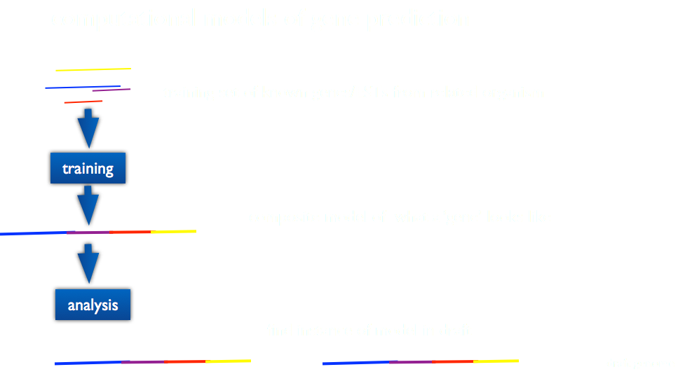
Annotating an assembly
ab initio
Notes:
Ab initio is much more complicated. These systems use a training set of known genes, often including ESTs or other evidence from the target or a related organism to create a composite model of what a gene is, Then theres a finding step that scans the draft genome to find these instances.

Slide 31
Annotating an assembly
Gene prediction programs
Augustus
GENEID
GeneMark
FGENESH
GLIMMER
SNAP…
Gene prediction pipelines
MAKER 2 / MAKER P
PROKKA
Notes:
Naturally there are loads of different gene prediction programs available, all working slightly differently and needing slightly different training information. But they’re all good and using them in combination to generate multiple models and condensing into a consensus is a good strategy.
In fact, its what these pipeline based tools. The MAKER and PROKKA pipelines are two good examples of pipelines that run lots of these tools and compress the output into consensus models, as well as incorporating experimental data like RNAseq if you have it.
These also have the advantage that there are online versions so you can test it out without much headache if you want to

Slide 32
No big red buttons in bioinformatics
Notes:
Ok,
So thats all I want to say about genome assembly. I just want to push the point that whatever way you go about assembling a genome – its always going to be at best a good guess, first drafts are often more wrong than you’d hope – and thats ok, because the whole process is iterative. You don’t need to get a gold standard genome often, you just need one that’s good enough for you purposes. Remember to be sceptical about every gene call and every contig and do every control step you can – you can’t just hit the button and expect the answer to pop out.

Slide 33
Acknowledgements
Michael Schatz @ CSHL
References and slides
https://github.com/danmaclean/mpmi_training

